Slide 1
Introduction to Computer Graphics
Parameterization

Slide 2
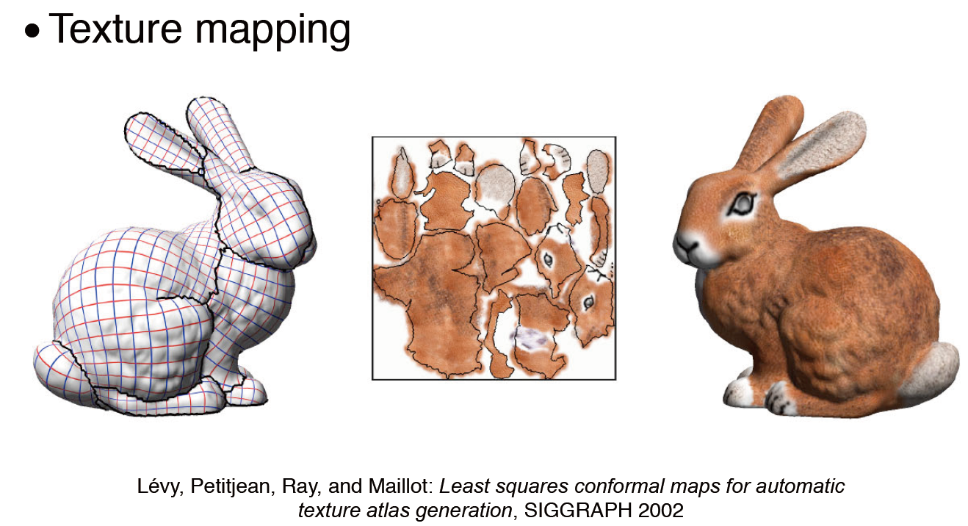
Motivation

Slide 3
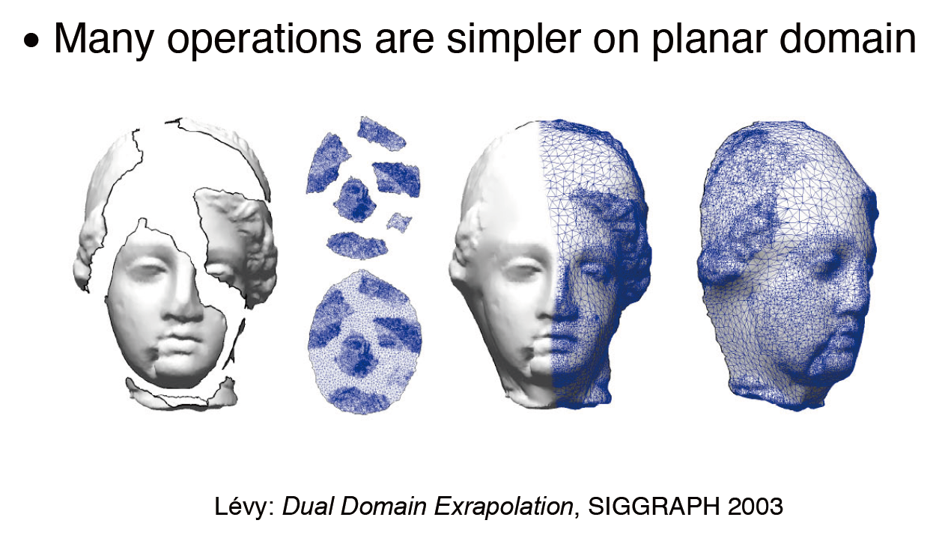
Motivation

Slide 4
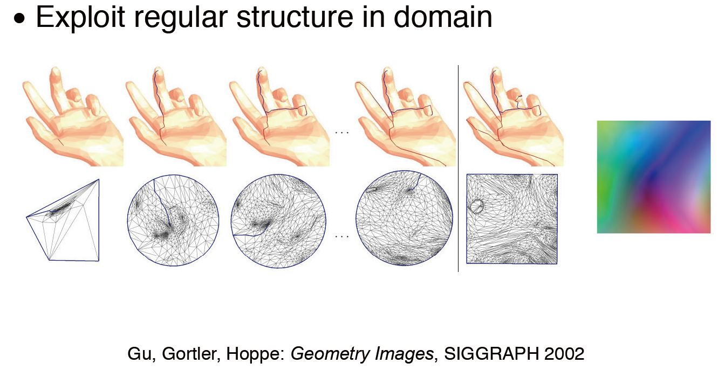
Motivation

Slide 5
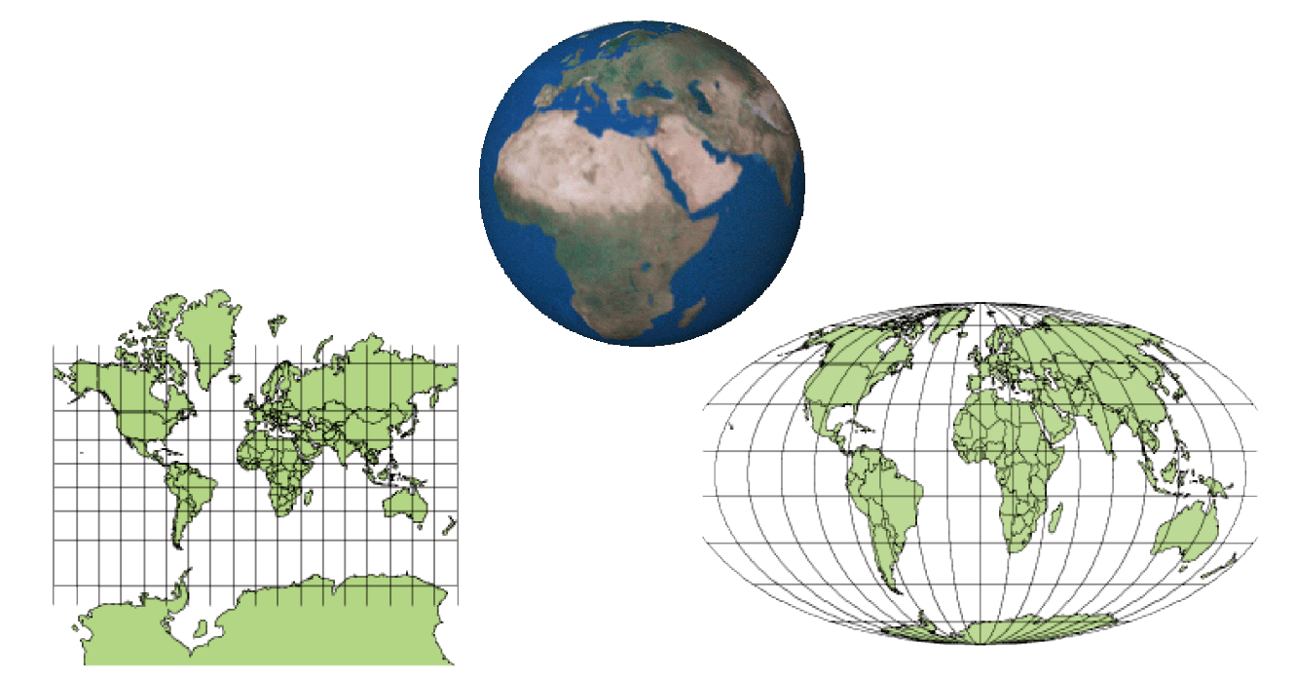
Surface Parameterization
Mercator-Projektion
Mollweide-Projektion
www.wikipedia.de

Slide 6
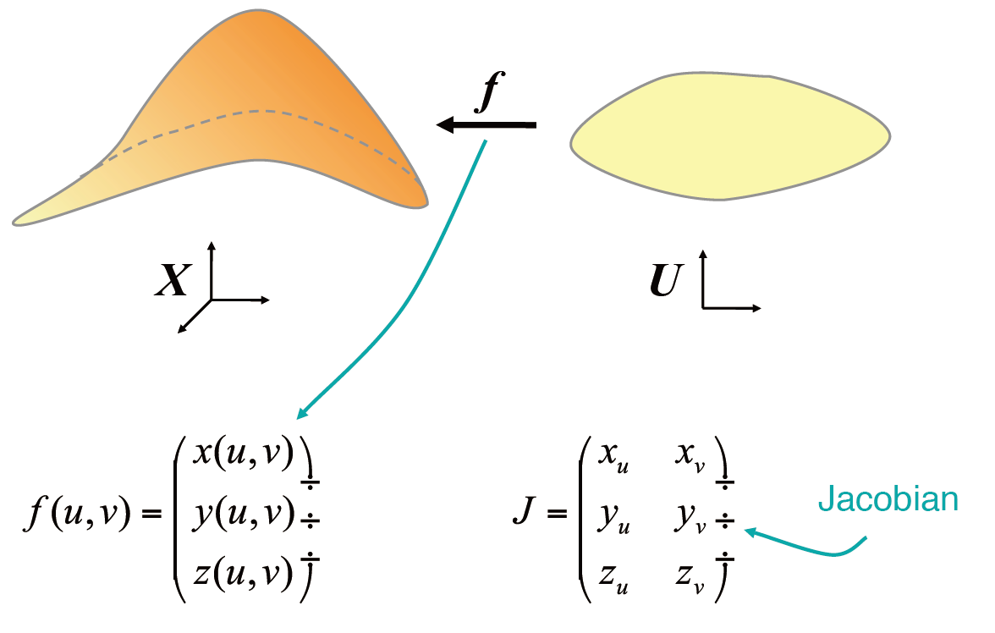
Surface Parameterization

Slide 7
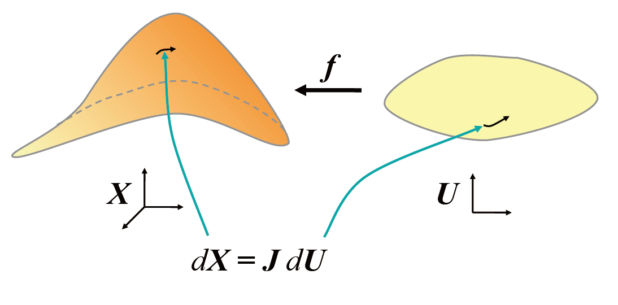
Surface Parameterization

Slide 8
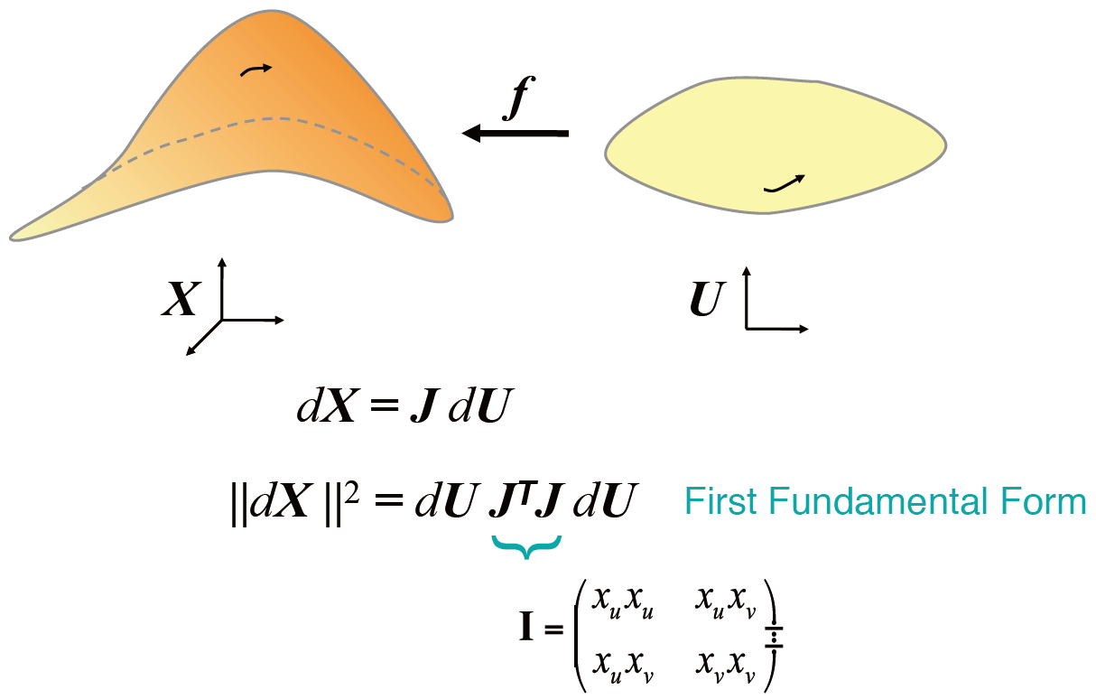
Surface Parameterization

Slide 9
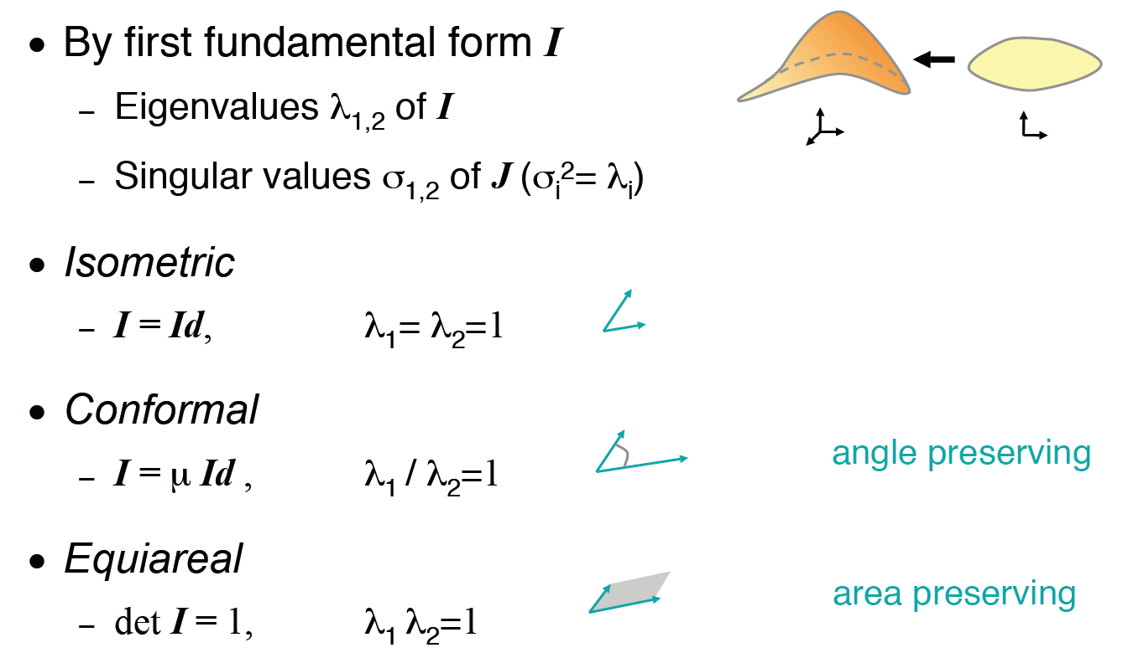
Surface Parameterization

Slide 10
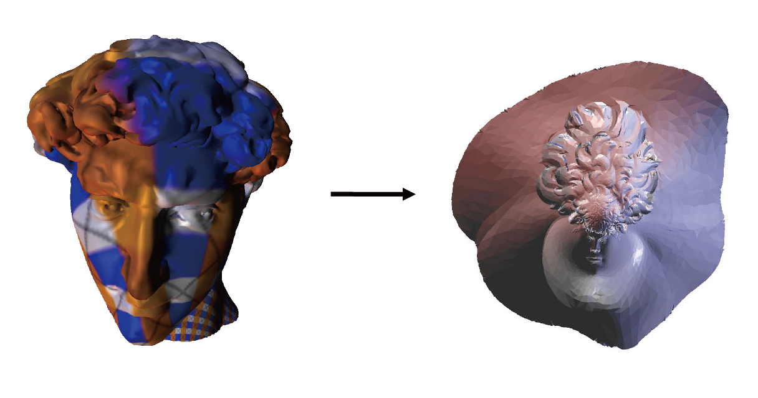
Surface Parameterization

Slide 11
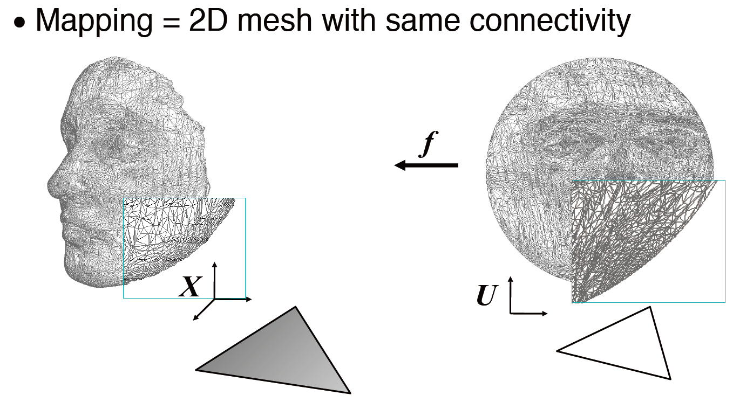
Surface Parameterization

Slide 12
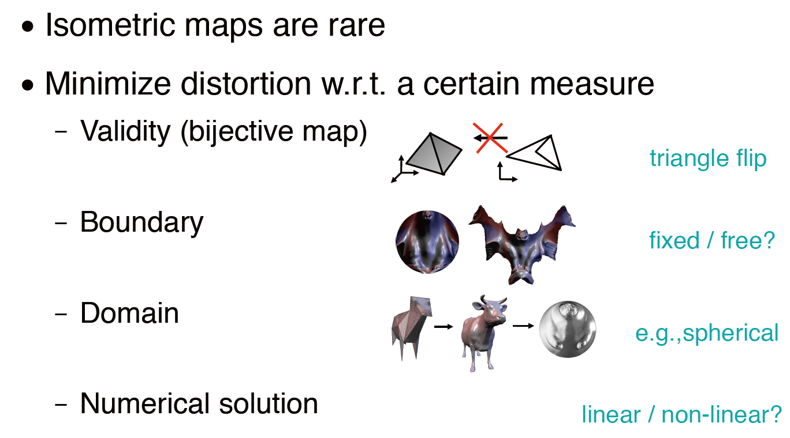
Objectives

Slide 13
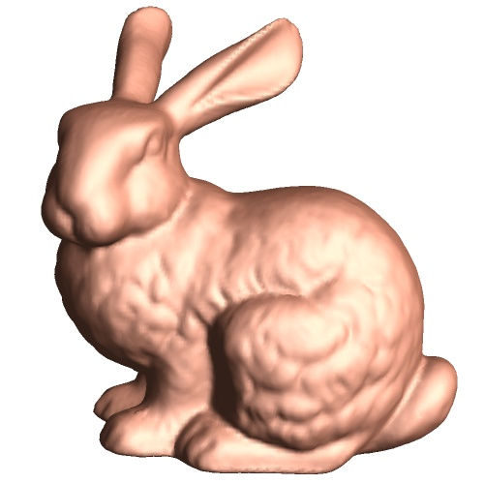
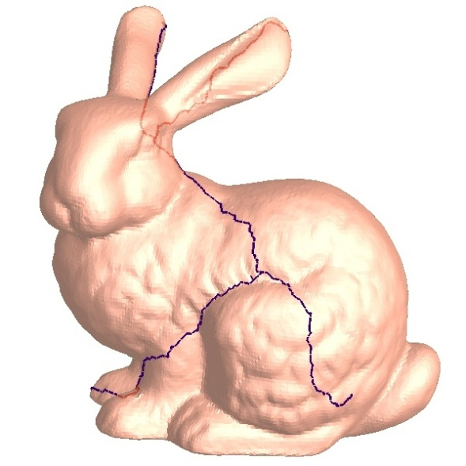
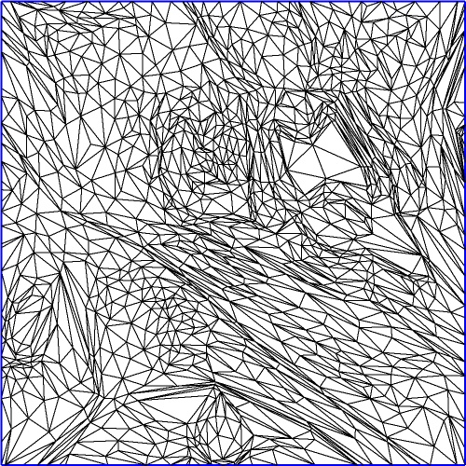
Planar Parameterization
cut
parametrize
Application

Slide 14
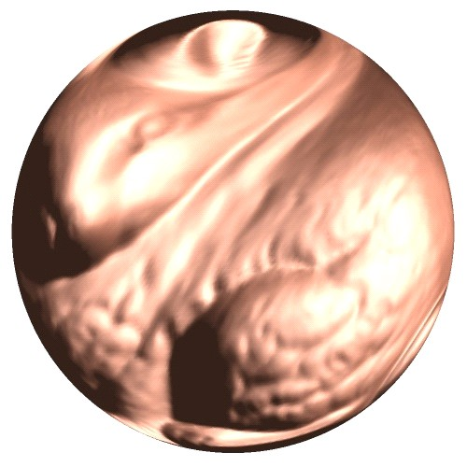

Spherical Parameterizaiton

Slide 15
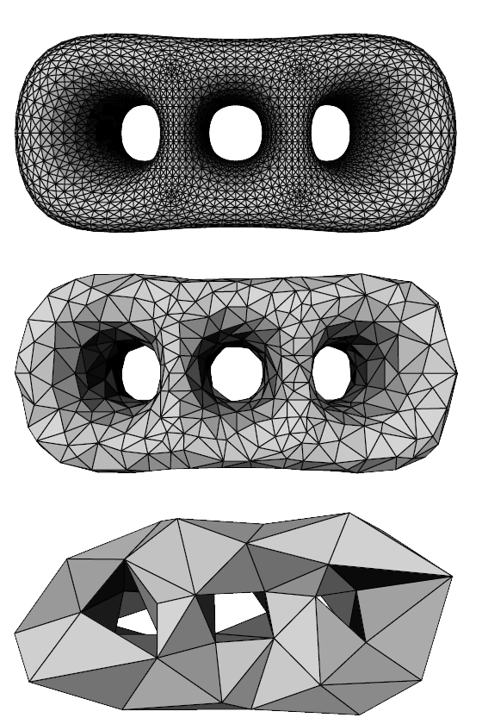
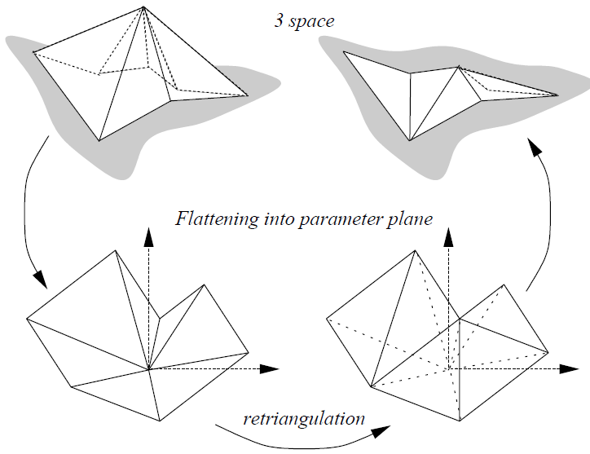
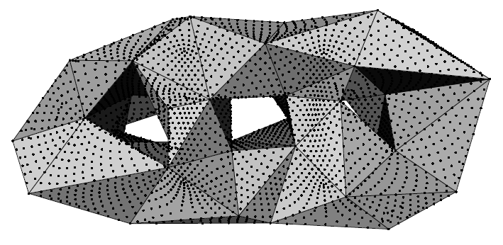
MAPS: Multiresolution Adaptive Parameterization of Surfaces

Slide 16
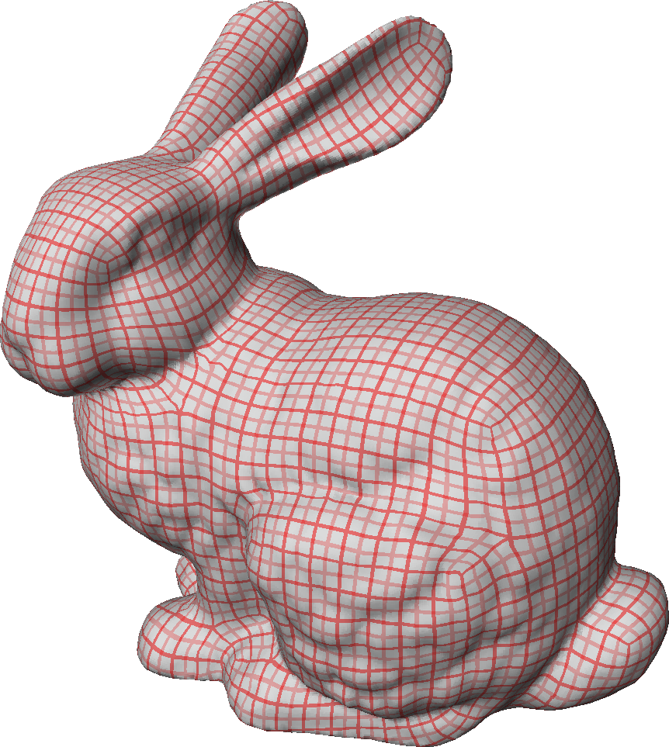
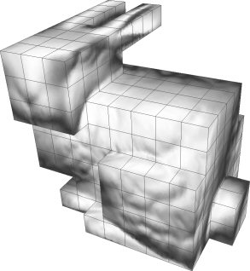
PolyCube Parameterization
w
v
u

Slide 17
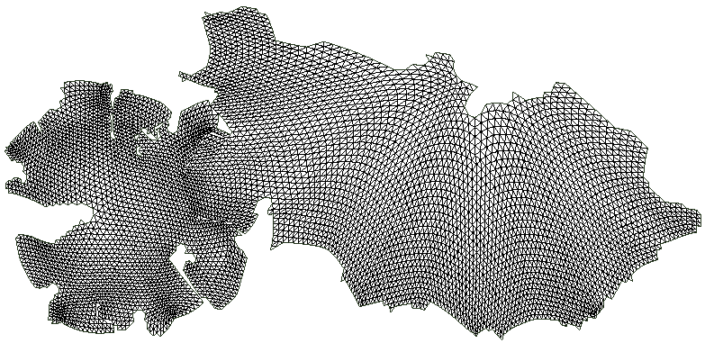
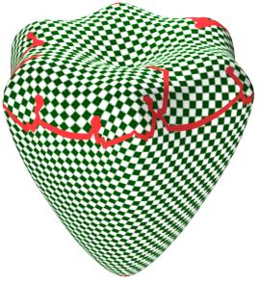
Bounded-distortion Piecewise Mesh Parameterization

Slide 18
The 3D surface
The planar patch

Slide 19
The 3D surface
The planar patch

Slide 20
The 3D surface
The planar patch

Slide 21
The 3D surface
The planar patch

Slide 22
The 3D surface
The planar patch

Slide 23
The 3D surface
The planar patch

Slide 24
The 3D surface
The planar patch

Slide 25
The 3D surface
The planar patch

Slide 26
The 3D surface
The planar patch

Slide 27
The 3D surface
The planar patch

Slide 28
The 3D surface
The planar patch

Slide 29
The 3D surface
The planar patch

Slide 30
The 3D surface
The planar patch

Slide 31
The distortion metric
p₃
q₃
S
T
T’
p₁
p₂
q₁
q₂
In 2D
In 3D

Slide 32
The distortion metric
The Jacobi matrix of S is 3x2 real matrix:
The singular values of J are:

Slide 33
The distortion metric
The values γ_{max} and γ_{min} are the maximal stretching and shrinking caused to a unit-length vector by the mapping S.
We want to equally “punish” stretch and shrink, therefore we define:
D(T, T’) = max{γ_{max} , 1/ γ_{min} }
Any other reasonable metric can be used!

Slide 34
Flattening a single vertex

Slide 35
Flattening a single vertex
The obtained position v can be used as initial guess for a relaxation procedure that finds better position v’ (for example, minimizes the average distortion of triangles incident to the vertex).
However, it is slower, and the initial guess performs well in practice.

Slide 36
Vertex grade components
Maximal distortion caused to the triangles flattened with the vertex. If it’s greater than the threshold, the grade is set to zero and the vertex can’t be flattened in the current patch!
The ratio between patch area and squared perimeter (to create round patches with small boundary length).
Crease angles or other segmentation information.
More criteria…

Slide 37
Checking self-intersections
Local self-intersection – triangle flipping

Slide 38
Checking self-intersections
Global self-intersections: maintain space partition data structure, check the new triangles with the existing boundary triangles.

Slide 39
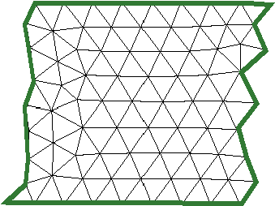
Adding seams
After the patch is finished, we may add seams as a post-process, to benefit from cylinder-like structure.

Slide 40
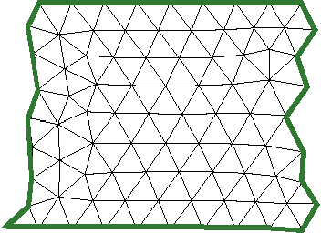
Adding seams
After the patch is finished, we may add seams as a post-process, to benefit from cylinder-like structure.

Slide 41
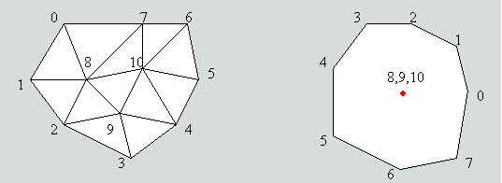
Simple Parameterization
First, place all boundary vertices on a convex 2D polygon, ex. on the circle
Place the inner vertices on the center
Y
X
3D polygon
2D plane

Slide 42
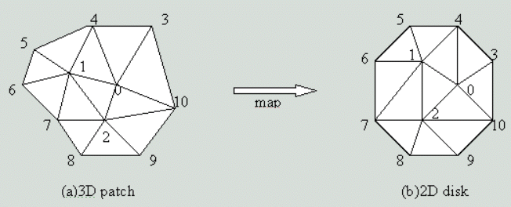
Simple Parameterization
Run this process iteratively until convergence
Y
X

Slide 43
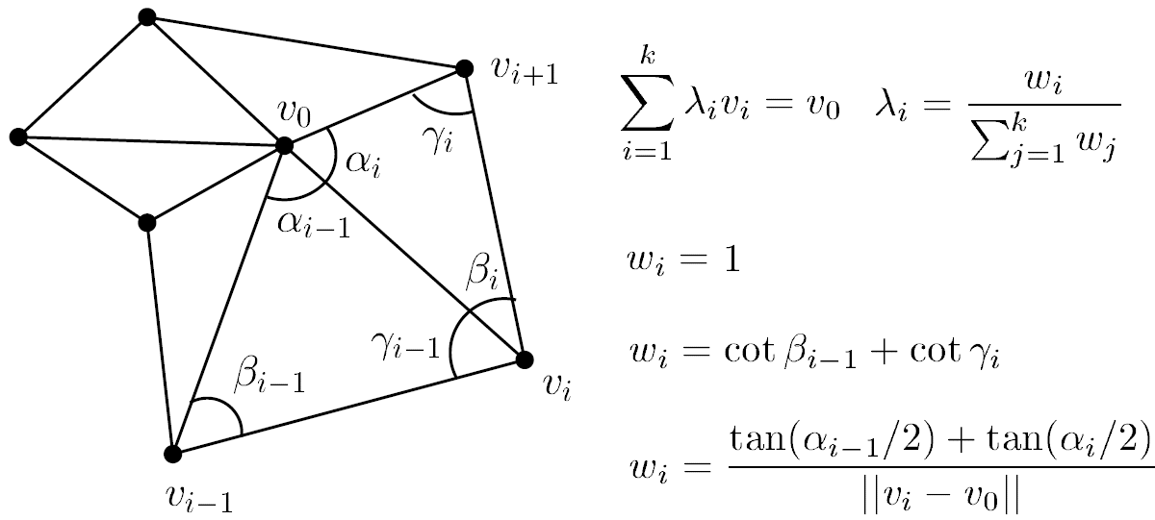
Simple Parameterization
W. T. Tutte [1960] – barycentric map
M. Eck et al. [1995] – harmonic map
M. S. Floater [2003] – mean value coordinates

Slide 44
AX=B, X=A⁻¹B

Slide 45
Linear System Library
OpenCV
Powerful Library for image processing
Linear system also support
OpenNL
Numerical Library and support CUDA solver
Tacus
Solve Linear system
Eigen

Slide 46
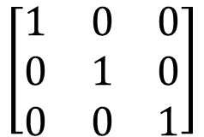
Ax=B
#include <Eigen/Sparse>
using namespace Eigen;
// 填A矩陣
SparseMatrix<double> A(3, 3);
A.insert(0, 0) = 1.0;
A.insert(1, 1) = 1.0;
A.insert(2, 2) = 1.0;
A.makeCompressed();
$$\left[\begin{matrix}1 & 0 & 0 \\ 0 & 1 & 0 \\ 0 & 0 & 1\end{matrix}\right]$$
A

Slide 47
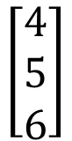
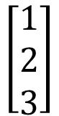
// 填B矩陣
std::vector<VectorXd> B;
B.resize(2); //B is 2D
B[0].resize(3);
B[1].resize(3);
B[0][0] = 1.0; B[0][1] = 2.0; B[0][2] = 3.0;
B[1][0] = 4.0; B[1][1] = 5.0; B[1][2] = 6.0;
$$\left[\begin{matrix}1 \\ 2 \\ 3\end{matrix}\right]$$
$$\left[\begin{matrix}4 \\ 5 \\ 6\end{matrix}\right]$$
B[0]
B[1]

Slide 48
// 利用 SparseQR 來解 AX = B
SparseQR<SparseMatrix<double>, COLAMDOrdering<int>> linearSolver;
linearSolver.compute(A);
std::vector<VectorXd> X;
X.resize(2);
X[0] = linearSolver.solve(B[0]);
X[1] = linearSolver.solve(B[1]);
X[0][0]
X[0][1]
X[0][2]
X[1][0]
X[1][1]
X[1][2]
X

Slide 49
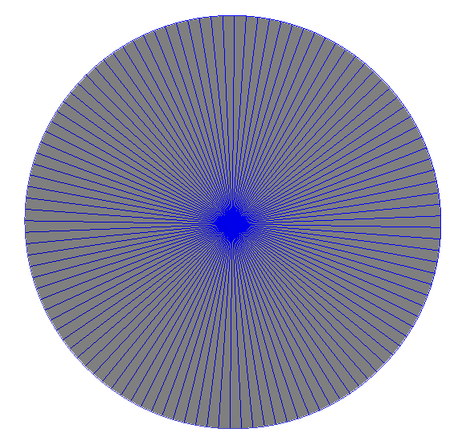
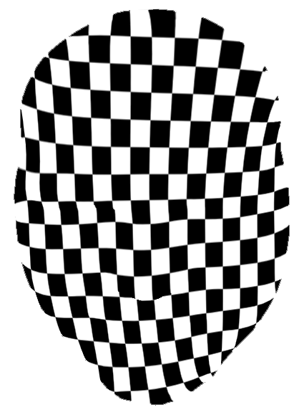
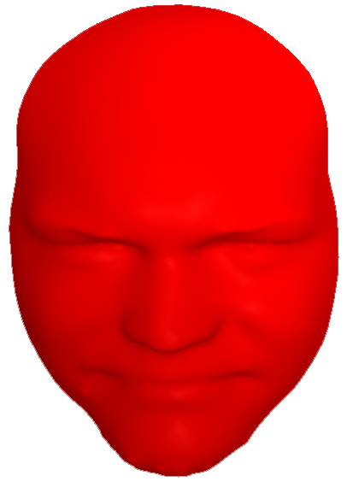
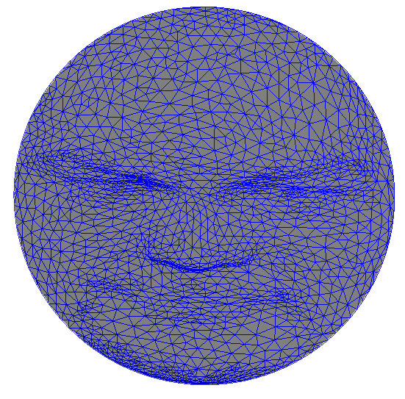
Homework

